Slide 1




Slide 2
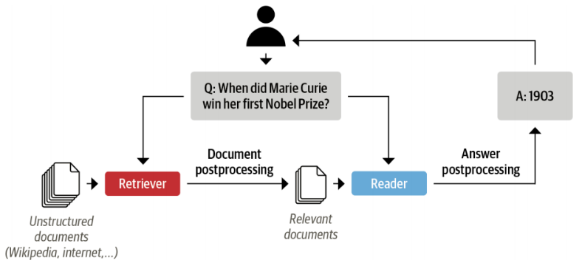
In the last Video
Simple Answer Extraction
One way to do this would be to concatenate all the reviews of a given product together and feed them to the model as a single and long context.
The drawback of this approach is that the context can become extremely long and thereby introduce an unacceptable latency for our users’ queries.
Question
QA Model
Answer
Context
Reality QA System

Slide 3
QA systems based on the retriever-reader architecture
Notes:
Hello and welcome, in this video we will start to dive into the components of the internal structure of transformers.

Slide 4
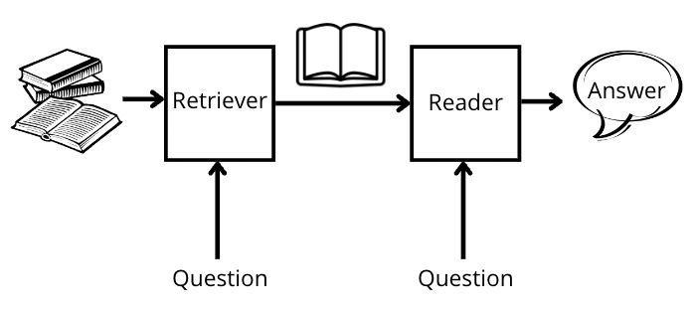
Introduction
The Retriever which is responsible for retrieving relevant documents for a given query.
The Reader that responsible for extracting an answer from the documents provided by the retriever.

Slide 5
Retrievers Types
Retrievers are usually categorized as sparse or dense.
Sparse retrievers:
use word frequencies to represent each document and query as a sparse vector.
The relevance of a query and a document is then determined by computing an inner product of the vectors.
Dense retrievers:
use encoders like transformers to represent the query and document as contextualized embeddings (which are dense vectors).
These embeddings encode semantic meaning and allow dense retrievers to improve search accuracy by understanding the content of the query.

Slide 6

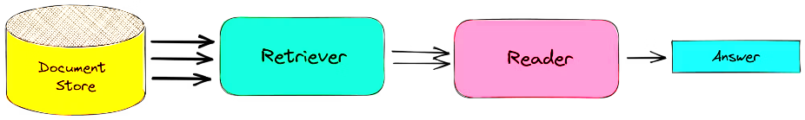
Haystack library
Haystack is based on the retriever-reader architecture, abstracts much of the complexity involved in building these systems and integrates tightly with Transformers.
Component of building a QA pipeline with Haystack:
The retriever
The reader
Document store: A document-oriented database that stores documents and metadata which are provided to the retriever at query time.
Pipeline: Combines all the components of a QA system to enable custom query flows, merging documents from multiple retrievers.

Slide 7
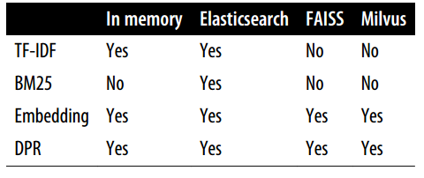

What’s Document store?
In Haystack, there are various document stores to choose from, such as in memory document store and Elasticsearch and each one can be paired with a dedicated set of retrievers.
ElasticsearchDocumentStore, which is compatible with both retriever types.
Sparse retrievers
Dense retrievers

Slide 8
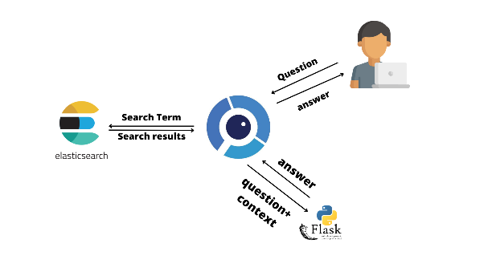
What’s Elasticsearch?
Elasticsearch is a search engine that is capable of handling a diverse range of data types including textual, numerical, geospatial, structured, and unstructured
Advantage of Elasticsearch
Store huge volumes of data
Quickly filter it with full-text search features
Makes it especially well-suited for developing QA systems.
Being the industry standard for infrastructure analytics, so there’s a good chance your company already has a cluster that you can work with.

Slide 9
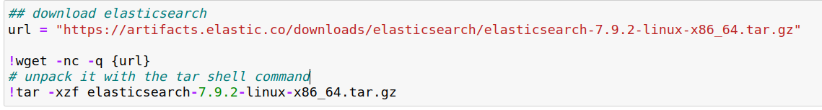
Initializing a document store
To initialize the document store, we first need to download and install Elasticsearch.
By following Elasticsearch’s guide:

Slide 10
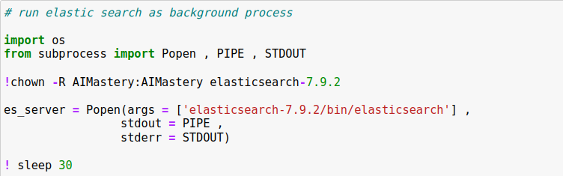
Initializing a document store
To initialize the document store, we first need to download and install Elasticsearch.
By following Elasticsearch’s guide:
1. Start the Elasticsearch server:
Popen() function to spawn a new process
The chown shell command run the subprocess in the background.
In the Popen function args: stdout=PIPE creates a new pipe for the standard output.
stderr=STDOUT collects the errors in the same pipe.

Slide 11
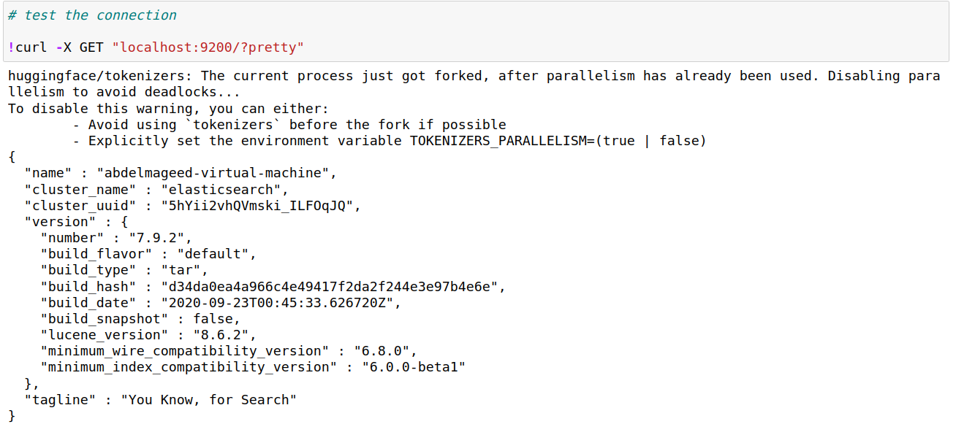
Initializing a document store
2. Test the connection by sending an HTTP request to localhost.

Slide 12
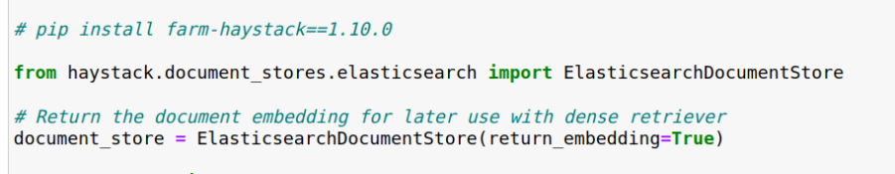
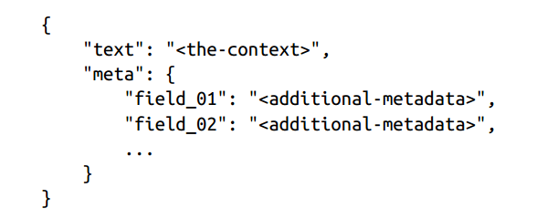
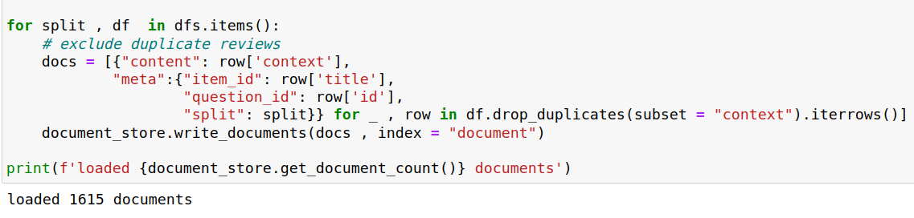
Initializing a document store
3. Instantiate the document store.
By default, ElasticsearchDocumentStore creates two indices on Elasticsearch:
one called document storing documents
label for storing the annotated answer spans
4. Populate the document index with the SubjQA reviews

Slide 13
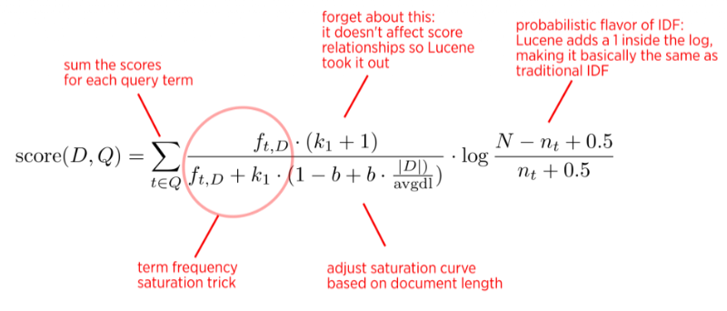
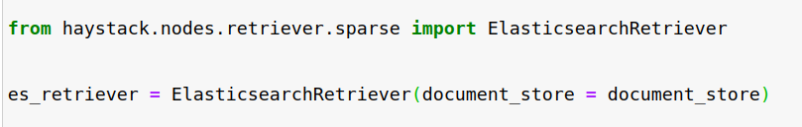
Initializing a retriever
The Elasticsearch document store can be paired with any of the Haystack retrievers.
Using a sparse retriever based on BM25 “Best Match 25”:
BM25 is an improved version of the classic Term Frequency-Inverse Document Frequency (TF-IDF) algorithm
represents the question and context as sparse vectors that can be searched efficiently on Elasticsearch.
The BM25 score measures how much matched text is about a search query and improves on TF-IDF by saturating TF values quickly and normalizing the document length so that short documents are favored over long ones.

Slide 14
Initializing a retriever
The score that Elasticsearch computed for its relevance to the query where larger scores imply a better match.
Filter the candidate documents by applying a Boolean test (does the document match the query?).
Apply a similarity metric that’s based on representing both the document and the query as vectors.
<Document: {'content': 'This is a gift to myself. I have been a kindle user for 4 years and this is my third one. I never thought I would want a fire for I mainly use it for book reading. I decided to try the fire for when I travel I take my laptop, my phone and my iPod classic. I love my iPod but watching movies on the plane with it can be challenging because it is so small. Laptops battery life is not as good as the Kindle. So the Fire combines for me what I needed all three to do. So far so good.', 'content_type': 'text', 'score': 0.6857824513476455, 'meta': {'item_id': 'B0074BW614', 'question_id': '868e311275e26dbafe5af70774a300f3', 'split': 'train'}, 'embedding': None, 'id': '252e83e25d52df7311d597dc89eef9f6'}>

Slide 15
Initializing a reader
Haystack reader types of extract answers from a given context:
1- FARMReader
Based on deepset’s FARM framework for fine-tuning and deploying transformers.
Compatible with models trained using Transformers and can load models directly from the Hugging Face Hub.
2- TransformersReader
Based on the QA pipeline from Transformers. Suitable for running inference only.
Differences between them in the way the predictions are converted to produce answers:
In Transformers, the QA pipeline normalizes the start and end logits with a SoftMax in each passage.
This means that it is only meaningful to compare answer scores between answers extracted from the same passage, where the probabilities sum to 1.
For example, an answer score of 0.9 from one passage is not necessarily better than a score of 0.8 in another.
In FARM, the logits are not normalized, so inter-passage answers can be compared more easily.
The TransformersReader sometimes predicts the same answer twice, but with different scores. This can happen in long contexts if the answer lies across two overlapping windows. In FARM, these duplicates are removed.

Slide 16
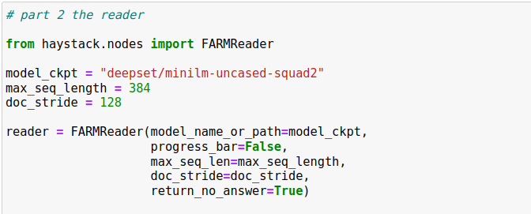
Initializing a reader

Slide 17
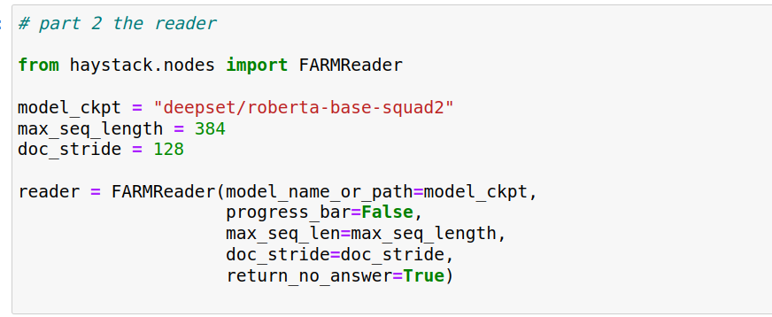
Initializing a reader

Slide 18
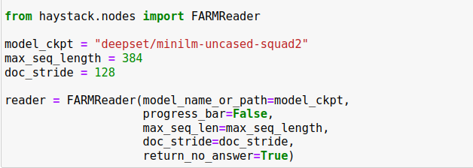
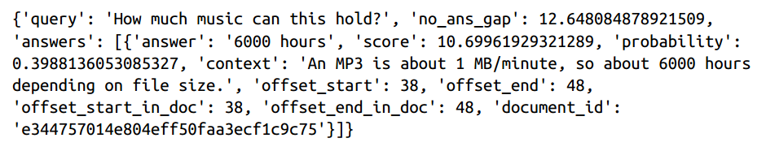
Initializing a reader
Test the reader:

Slide 19
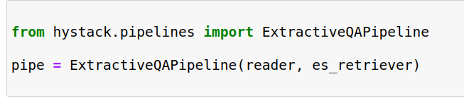
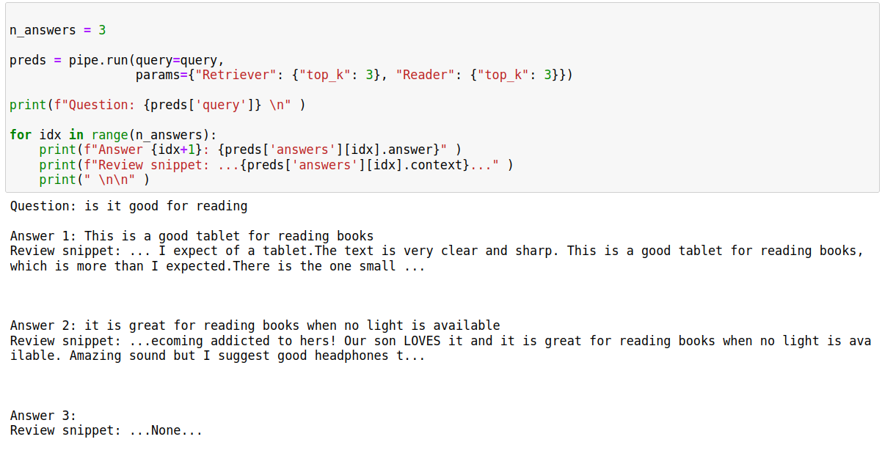
Putting it all together
Haystack Pipeline:
provides a abstraction that allows us to combine retrievers, readers, and other components together as a graph that can be easily customized for each use case.

Slide 20
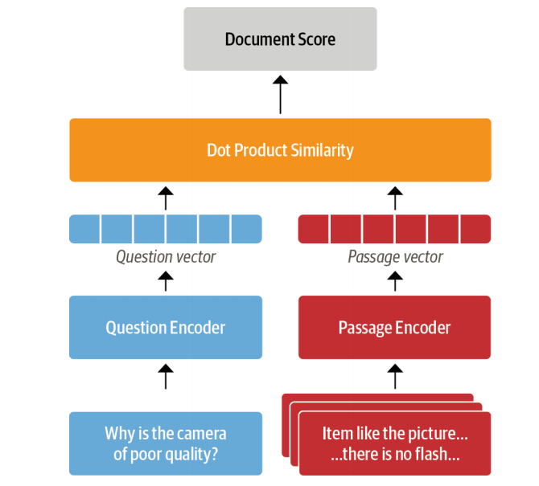
Dense Passage Retrieval (DPR)
Limitation of sparse retrievers like BM25
Can fail to capture the relevant documents if the user query contains terms that don’t match exactly those of the review.
Dense Passage Retrieval (DPR):
The main idea behind DPR is to use two BERT models as encoders for the question and the passage.
These encoders map the input text into a d-dimensional vector representation of the Classification token.

Slide 21
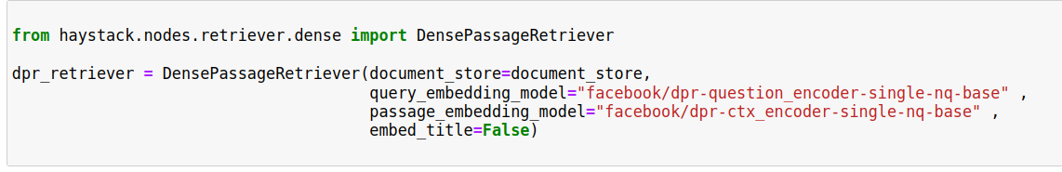

Dense Passage Retrieval (DPR)
These encoders are trained by giving them questions with relevant (positive) passages and irrelevant (negative) passages, where the goal is to learn that relevant question-passage pairs have a higher similarity.
set embed_title=False since concatenating the document’s title like item_id doesn’t provide any additional information because we filter per product.
Initialized the dense retriever:
The next step:
iterate over all the indexed documents in our Elasticsearch index and apply the encoders to update the embedding representation.

Slide 22
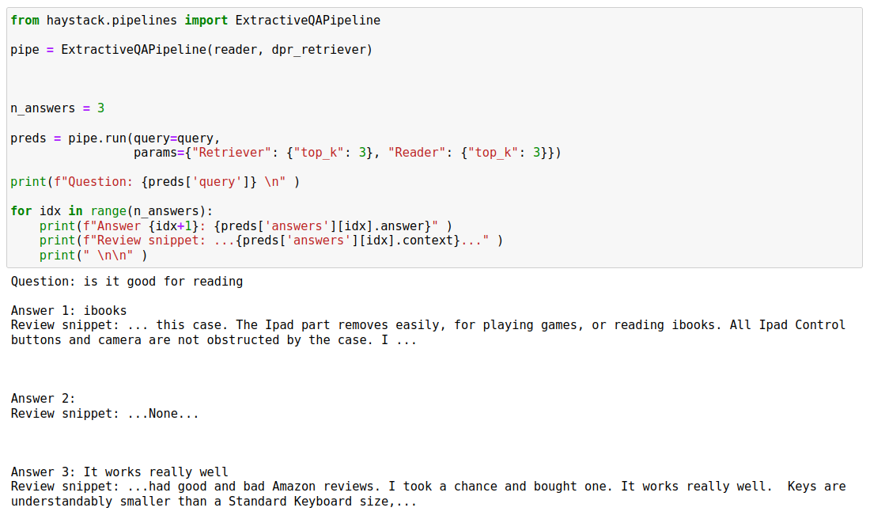
Dense Passage Retrieval (DPR)
Results: DPR method is not good as sparse method
Solution:
One of the solution is to choose another pretrained reader model like Roberta.
fine tune a pretrained model on your own dataset that is a great idea for domain adaption.
Not only the reader model but also you can fine tune the retriever model as well.

